Slide 1


SMART INDIA HACKATHON 2024
Problem Statement ID – SIH1554
Problem Statement Title - Smart Irrigation System for Precise Farming
Theme - Agriculture, Food Tech & Rural Development
PS Category- Hardware
Team ID - 11369
Team Name - Rainbow Warriors

Slide 2
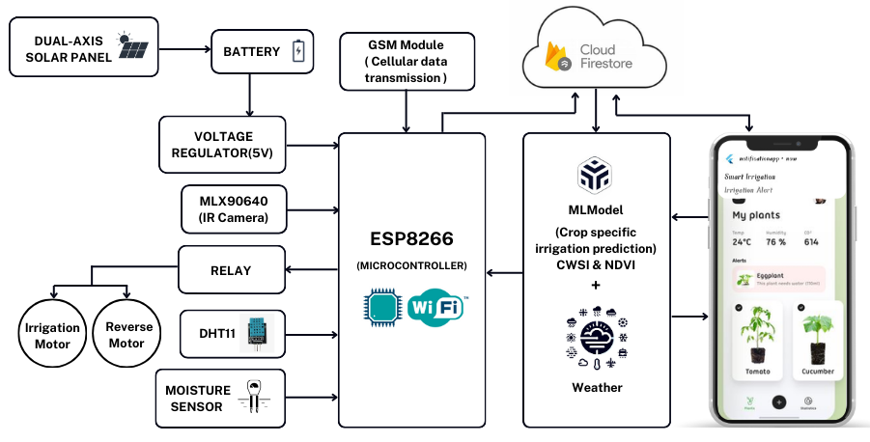
IDEA TITLE
Rainbow Warriors
IDEA / SOLUTION :
Implementation of Automatic Crop-Specific Irrigation System Based on AI & CWSI / NDVI Values
Micro-Controller (ESP8266) : The real time data collected through sensors are sent to firebase using the micro-controller.
AI-Driven Irrigation : The AI will get all the input from firestore and predicts the crop specific irrigation cycle efficiently(eg. tomato plant can survive without water upto 2 days still producing the same amount of yieldings produced when we irrigate everyday) and it works synchronized with the weather api.
CWSI & NDVI : These values are calculated to measure the precise amount of water required by the crops.
Reverse Motor System : Sucks flood water and stores in cistern.
Flutter App : The user selects the crop planted and all the real-time data are displayed to the user. The app gives timely notifications to the user regarding the Weather AI and Irrigation Status.
Dual Axis Solar panels : Generates electricity for the whole system.
Firestore Storage: All the sensor, weather and AI data are stored in the firestore for trend analysis.
OUR UNIQUE VALUE PROPOSITIONS :
Crop- Specific Irrigation
AI trained with Manually Collected Dataset(Novel approach) & Weather Synchronized System. WSN Network.
CWSI(Crop Water Stress Index) & NDVI(Normalized Difference Vegitative Index) Based irrigation water supply
Reverse - motor(Cistern/Diversion system)
Trend - Analysis using Firebase Data

Slide 3
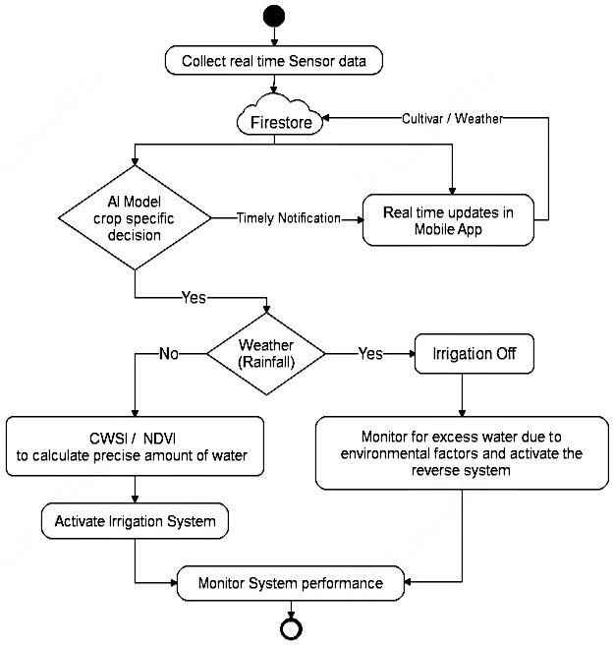
TECHNICAL APPROACH
Rainbow Warriors
TECH STACK :
PROCESS FLOW ARCHITECTURE :
App Devleopment :
Flutter : Dart language has been used to develop the user-friendly Smart app for farmers.
AI Model :
Voting Classifier : The Model integrates 11 powerful model’s efficiency to predict the irrigation.
Weather API : Integration of futuristic rainfall prediction.
CWSI & NDVI : Usage of IR Camera to monitor the age and water stress of crop to calculate the required amount of water.
Cellular Network : 4G Network for data transmission.
IoT :
Micro-Controller : It integrates the irrigation system with the AI as well as firestore.
Database and APIs :
Firestore : It stores all the data for trend analysis & to find Profit / Loss of Yields.
PRODUCT STATUS :
90% of the project is completed. the product is under testing stage.

Slide 4
FEASIBILITY AND VIABILITY
Rainbow Warriors
Your Team Name
STRATEGIES FOR OVERCOMING CHALLENGES :
FEASIBILITY ANALYSIS :
POTENTIAL CHALLENGES :
Dataset: the dataset to train our AI model not available since our approach was novel & completely new.
Initial Costs: High upfront costs for equipment and system development.
Farmer Adoption: Resistance due to unfamiliarity with technology or perceived complexity.
System Maintenance: Regular maintenance of hardware and software to ensure functionality.
Technical Feasibility : Leverages proven technologies; scalable with integration of sensors and AI.
Economic Feasibility : Highly cost efficient, low-cost components.
Operational Feasibility : User-friendly; requires minimal maintenance.
Environmental Feasibility: Supports sustainability; adapts to climate changes; reduces environmental impact.
Market Feasibility: Increasing demand for precision agriculture, has strong market demand potential.
Dataset: We have implemented our project and collected the real time 9 lakhs data to train our AI using firestore database.
Initial Costs: Seek grants, subsidies, or partnerships to reduce upfront expenses.
Farmer Adoption: Provide demonstrations, training, and support to build user confidence.
System Maintenance: Establish regular maintenance schedules and provide remote support options. Or Automate by the use of sensor fault detection system.

Slide 5
IMPACT AND BENEFITS
Rainbow Warriors
Your Team Name
POTENTIAL IMPACT :
BENEFITS OF THE SOLUTION :
MITIGATES WATER SCARCITY: By promoting efficient water use, the system reduces the risk of water shortages in agriculture-heavy regions.
REDUCES FLOOD DAMAGE: During heavy rainfall, your system can help divert excess water, minimizing the risk of crop loss and reducing soil erosion caused by floods.
ENHANCES FOOD PRODUCTION: Highly increases crop yields by supplying precise amount of water at required times.
PROMOTES SUSTAINABLE AGRICULTURE: The integration of precise irrigation and energy-saving technologies like solar panels fosters environmentally friendly farming practices, reducing the carbon footprint of agricultural operations.
LONG-TERM COST EFFICIENCY: Over time, the reduction in water, energy, and labor costs could lead to greater profitability for farmers, encouraging widespread adoption of sustainable farming technologies.
PRECISE WATER SUPPLY : By the use of CWSI and NDVI, the water supplied to the crops are calculated.
PREVENTS WATER SCARCITY : Efficient irrigation reduces water waste and promotes sustainability.
PREVENTS CROP SPOILAGE : During Rainy times, the crops are saved from heavy floods.
INCREASES CROP PRODUCTIVITY: Ensures optimal growing conditions and reduces crop stress.
COST SAVINGS : Reduces operational costs and minimizes resource wastage.
ELECTRICAL ENERGY CONSERVATION : Minimizes energy use through optimized irrigation scheduling and use of Solar panels.
@SIH Idea submission- Template

Slide 6
RESEARCH AND REFERENCES
Rainbow Warriors
Your Team Name
Our Direct Survey research from farmers - https://youtu.be/d1pFBcfyIwg
AI in Agriculture - https://youtu.be/JeU_EYFH1Jk?si=Hbtk_6lvrzb_AMKr
Solar panels for efficiency - https://youtu.be/2hwpXCjmkRo?si=82PMXKENRsUBmRyE
Irrigation Method - https://youtu.be/pROPzQILPaw?si=ZPvowvNgXm5zHAG4
Application of Artificial Intelligence for Satellite Imagery in Farming - https://youtu.be/Wczoc-oNOBY?si=egMJkDf3w0zWAXOO
CWSI-based Irrigation System Design-https://ieeexplore.ieee.org/document/10066983
Research on Intelligent Monitoring and Irrigation System for Farmland Based on IoT and 5GTechnology - https://ieeexplore.ieee.org/document/10209060
Sensor Node-Based Smart Irrigation System with IoT Framework - https://ieeexplore.ieee.org/document/10370640
Automated Smart Irrigation System using IoT with Sensor Parameter -https://ieeexplore.ieee.org/document/9751993

